Slide 1
INTELLIGENT HELMET LOCKING ALARM SYSTEM
PRESENTED BY: GROUP B6

Slide 2
Contents
01.
Problem statement
02.
Solution and Scope
03.
Final detailed architecture
04.
Complete design with components
05.
Software process
06.
Final product cost
07.
Next steps to marketize
08.
Problem faced
PAGE 02

Slide 3
Problem Statement
Motorcycle accidents caused by improperly secured helmets pose a serious safety concern.
Existing helmet locks do not provide real-time feedback on the helmet's locking status.
The lack of a reliable system to detect improperly locked helmets puts riders at risk.
A solution is needed to encourage responsible riding behavior and reduce preventable accidents.
PAGE 03

Slide 4
Solution and Scope
SOLUTIONS:
Implement an embedded system that includes sensor technology to detect the locking status of the helmet accurately.
Incorporate intelligent algorithms to process sensor data in real-time and determine the helmet's securement.
Integrate an alert mechanism, such as a beep sound, to provide instant feedback to the rider if the helmet is not locked properly.
Utilize power optimization techniques to ensure low power consumption and extended battery life.
Design a user-friendly calibration interface for easy customization and adjustment of system settings.
PAGE 04

Slide 5
Solution and Scope
SCOPE:
Develop a compact and cost-effective circuit to be integrated into the motorcycle helmet.
Create a sensor mechanism to detect the proper locking of the helmet, ensuring rider safety.
Design an efficient alerting system (beep sound) that notifies the rider in real-time if the helmet is not securely locked.
Ensure the system's reliability, responsiveness, and low power consumption to make it suitable for long-term use.
It will function effectively in various environmental conditions, including low-light and noisy environments.
PAGE 05

Slide 6
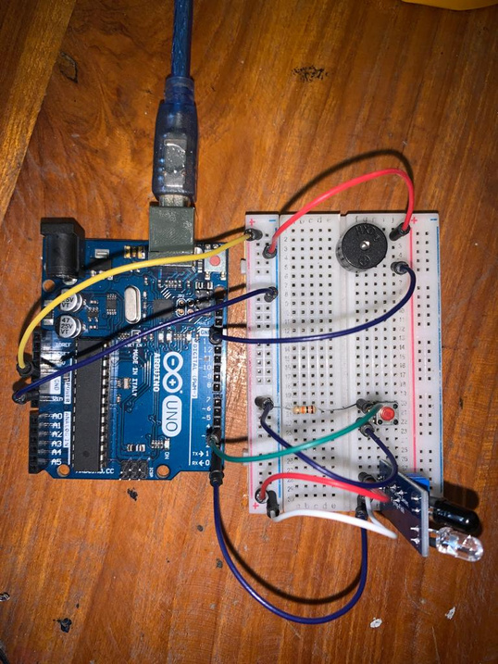
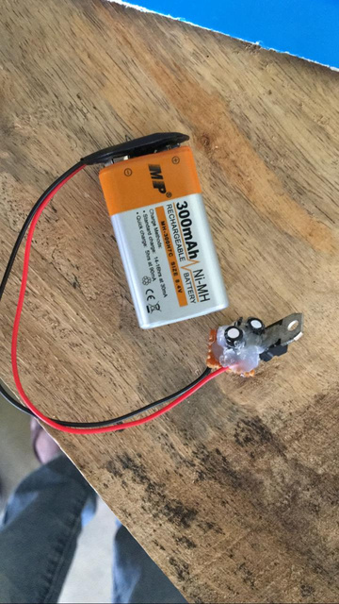
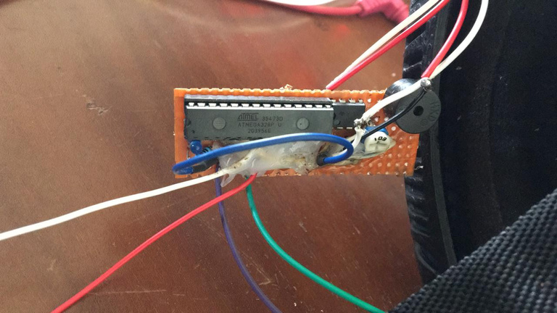
Final detailed architecture
PAGE 06

Slide 7
Complete design with components
1.IR sensor
2. ATmega 32 microcontroller
3. Jumper wires
4. LEDs
5. Vero board
6. 0.33uF capacitor 2
7. 7805 mosfet
8. 16MHz oscillator
9. 22pF capacitor 2
10. Potential meter
11. 9V battery
12. LM358 ic
13. Resistor
PAGE 07

Slide 8
Software Process
#include <avr/io.h>
#include <util/delay.h>
int main(void)
{
DDRB = DDRB | (1<<5); //declare PORTB5 as output
DDRD = DDRD & ~(1<<2); // PB2 ir, PB3 clip
DDRD = DDRD & ~(1<<3); //declare PIND2, and PIND3 as input
while(1)
{
if(PIND & 0b00001000)
{
_delay_ms(20000);
while(PIND |= 0b00001000){
PORTB = PORTB | (1<<5);
_delay_ms(100);
PORTB = PORTB & (0<<5);
_delay_ms(100);
}
}
else
{
PORTB = PORTB & (0<<5);
}
}
}
}
PAGE 09

Slide 9
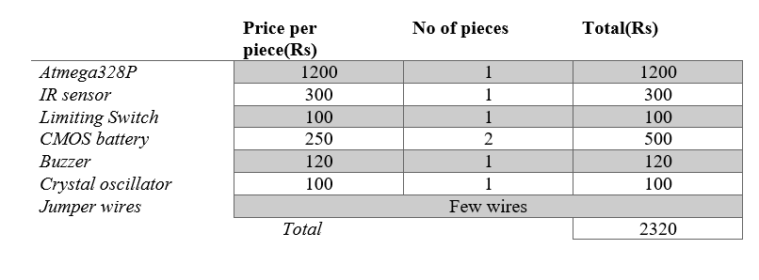
Final Product Cost
PAGE 10

Slide 10
Next Step to Marketize
Market Research
Identify Target Customers
Branding and Positioning
Product Packaging and Presentation
Pricing Strategy
Distribution Channel
Finally Marketing and Promotions
PAGE 11

Slide 11
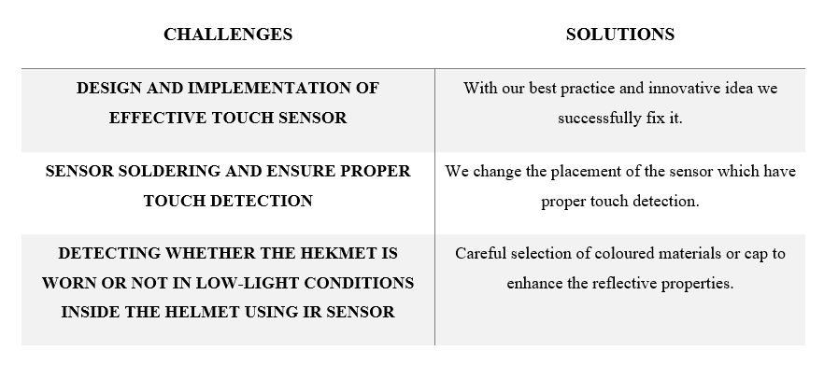
Problem Faced and Solution
PAGE 12

Slide 12
Thank you!
2019/E/129
2019/E/139
2019/E/140
PAGE 13

